Slide 1
The Universal Windows Platform
Developer’s guide for
Windows 10 preview
Andy & Jerry

Slide 2
Building a modern, fully-immersive Windows app for the Windows store that targets the common Universal Windows Platform on Windows 10
The definitive developer’s guide for
Windows 10 insider preview
Andy Wigley esquire & Jerry Nixon, developer executive

Slide 3
A single platform
One Windows
Many devices
Developer experience
Windows tooling
.Net Native
Template 10
http://aka.ms/template10

Slide 4

Introducing the UWP

Slide 5
Windows Core
The refactored common core
One hardware platform
Universal hardware driver
Standard network and I/O
Desktop SKU
Phone SKU
Xbox SKU
Windows Core
Desktop
Device
Phone
Device
Xbox
Device

Slide 6
One Windows
Desktop SKU
Mobile SKU
Xbox SKU
IoT SKU
IoT headless SKU
Surface Hub SKU
Holographic SKU
PC
2 in 1
Tablet
Phablet
Phone
Xbox
Band
Raspberry Pi
Surface Hub
HoloLens
Home Automation

Slide 7
Each family adds features to the one it inherits

Slide 8

The convergence journey
Xbox 360
Xbox One
Unified core and app platform
Converged
OS kernel
Windows 8.1
Windows 8
Converged
app model
Windows 10
Windows Phone 8.1
Windows Phone 8
Easy for users to get & stay current
Windows Phone 7.5
Windows on Devices

Slide 9
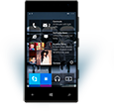

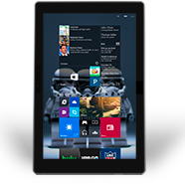
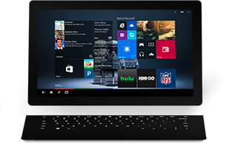

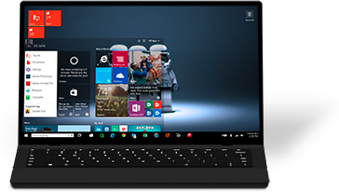

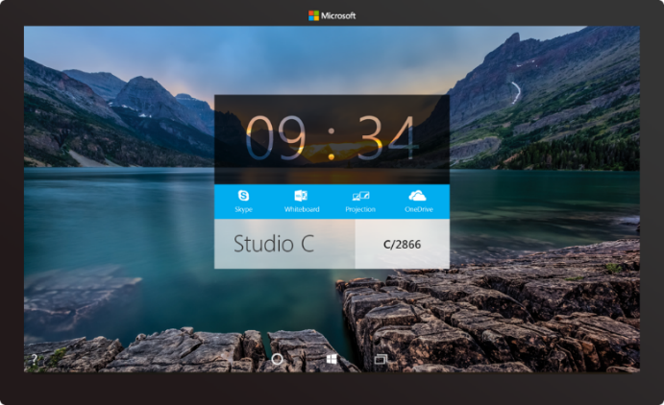

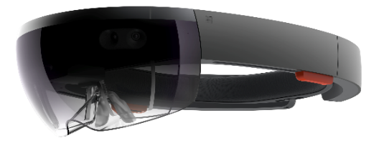



2-in-1s (Tablet or Laptop)
Classic Laptop
Desktops & All-in-Ones
Phone
Phablet
Small Tablet
Large Tablet
Windows 10
Surface Hub
Xbox
Holographic
IoT

Slide 10
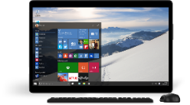
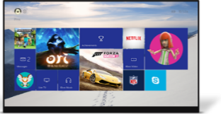
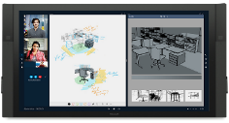
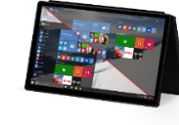
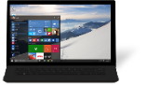
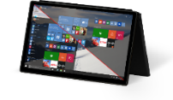
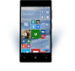
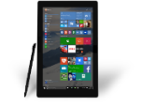
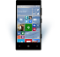











PC
XBox
Mobile
Surface Hub
Devices +IoT
HoloLens
Universal Windows Apps
Multiple device families
Adaptive User Interface
Reuse Existing Code
Natural User Inputs
One Store + One Dev Center
One SDK + Tooling
One Universal Windows Platform

Slide 11
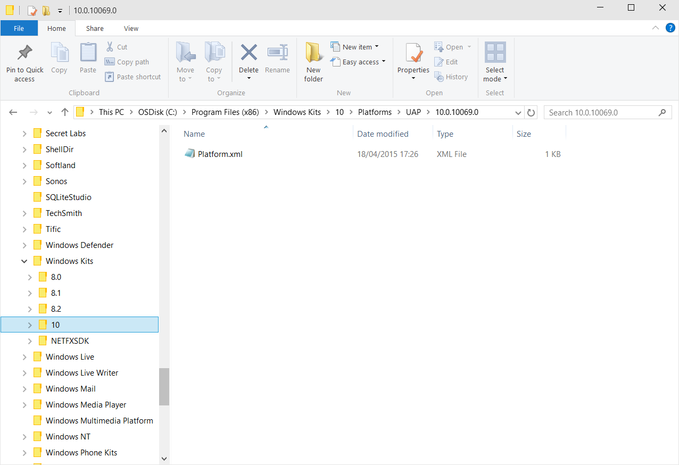
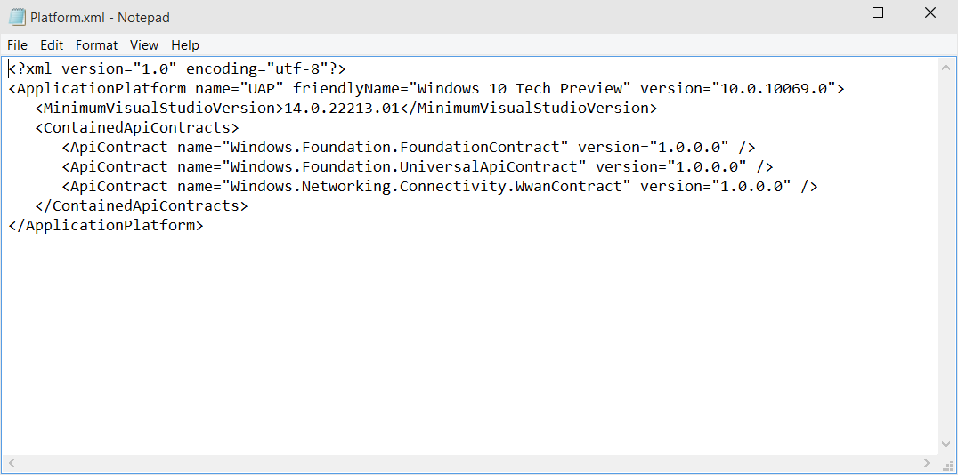
Universal Windows Platform
A single API surface
A guaranteed API surface
The same on all devices
Universal Windows Platform
Windows Core
Desktop
Device
Phone
Device
Xbox
Device

Slide 12
Apps don't target Windows 10, apps target the platform

Slide 13
<TargetPlatform
Name="Microsoft.Universal"
minVersion="10.0.10069.0"
maxVersionTested="10.0.10190.0"/>

Slide 14
The Universal Windows Platform can update at its own cadence

Slide 15
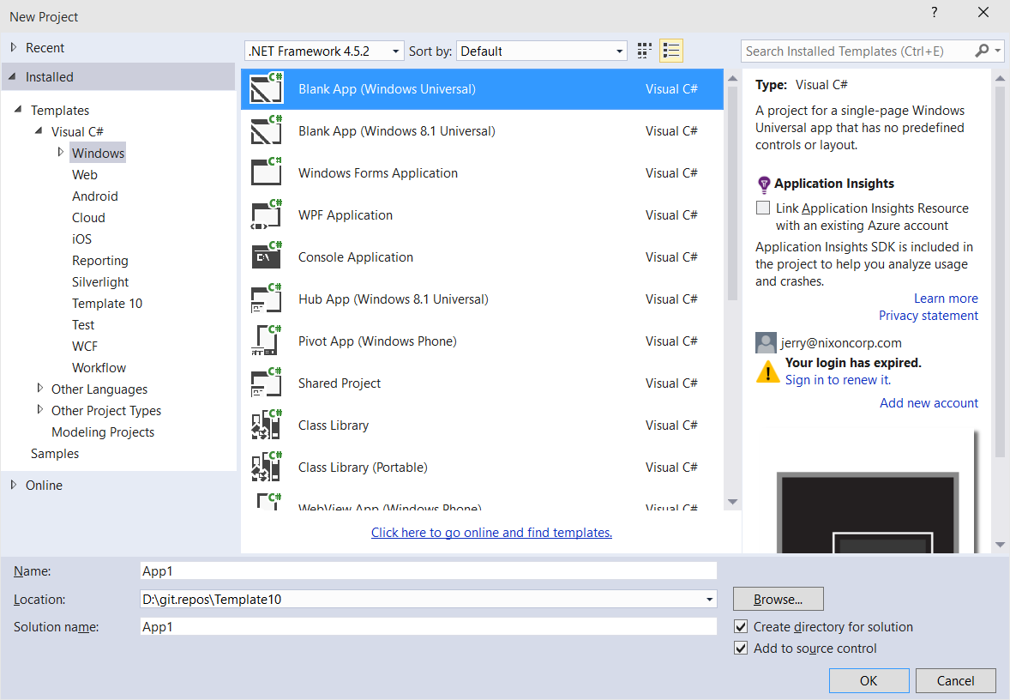
Windows app
A single binary
Running on any device
Testing for capabilities
Adjusting to devices
Windows App
Universal Windows Platform
Windows Core
Desktop
Device
Phone
Device
Xbox
Device

Slide 16
The developer story
When writing for iOS,
A developer writes for iPad & iPhone
When writing for Android,
A developer writes for all supported devices
When writing for Windows 8,
A developer writes for each devices
When writing for Windows 10,
A developer writes for every device

Slide 17
Hello devices
2:05

Slide 18
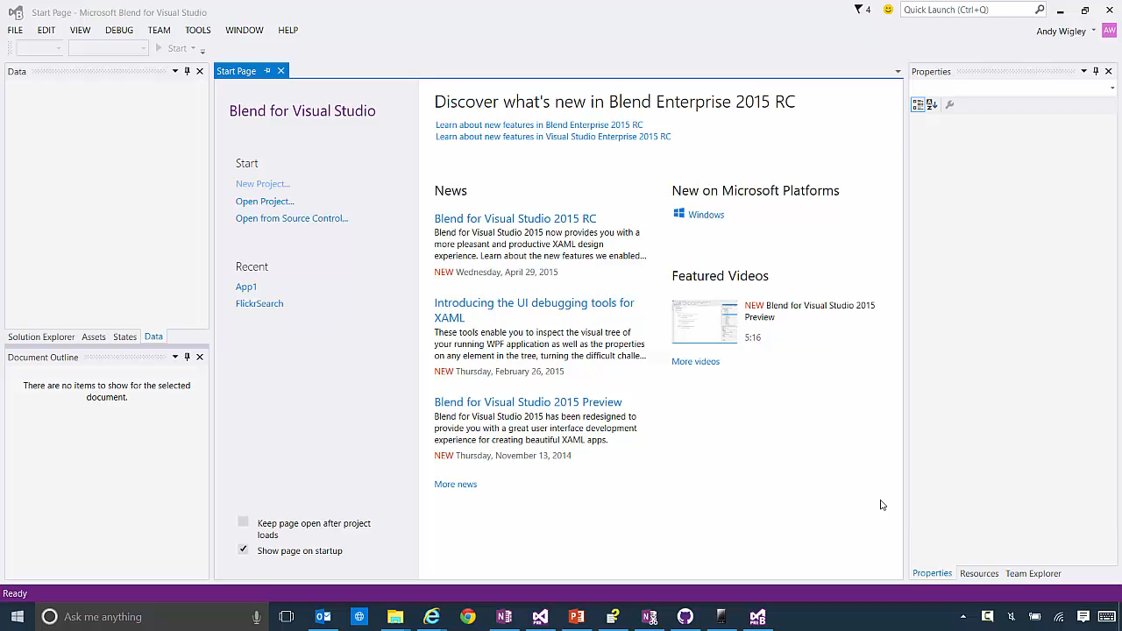

Slide 19
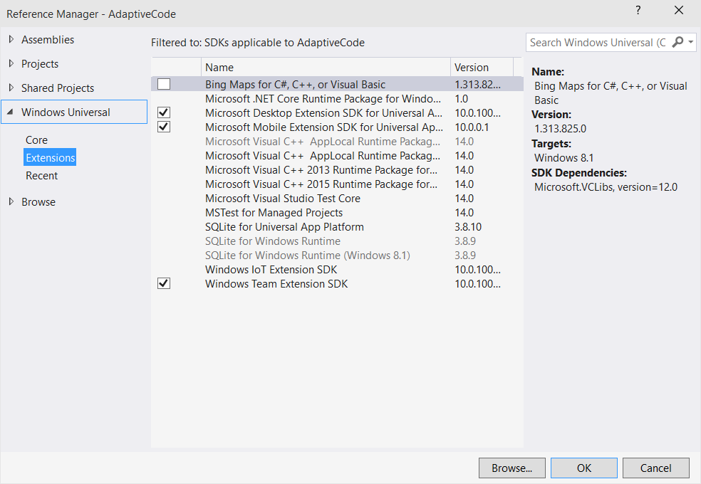
Platform extensions
Device-specific API
Family-specific capabilities
Compatible across devices
Unique update cadence
Windows App
Desktop
extension
Phone
extension
Xbox
extension
Universal Windows Platform
Windows Core
Desktop
Device
Phone
Device
Xbox
Device

Slide 20
Extensions don't invalidate binaries on other devices

Slide 21
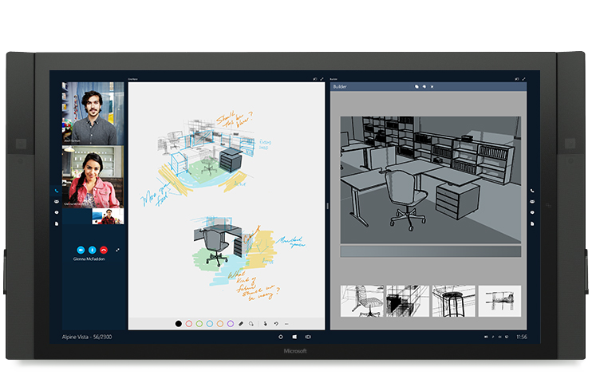
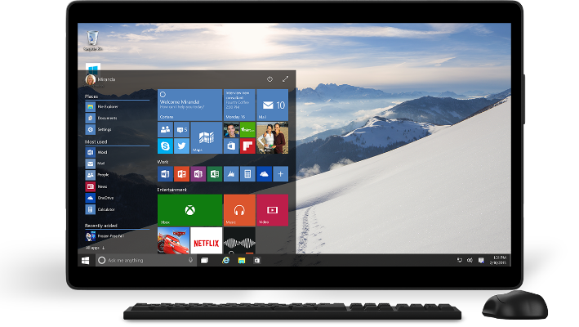
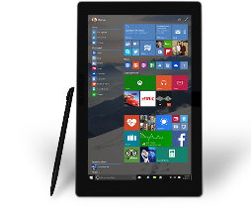

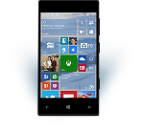
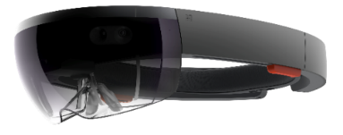
Universal Windows Platform
One Operating System
One Windows core for all devices
One App Platform
Apps run across every family
One Dev Center
Single submission flow and dashboard
One Store
Global reach, local monetization Consumers, Business & Education

Slide 22
Traditional Microsoft technologies are not the only way to create Windows apps

Slide 23
WPF
WF
MFC
XAML
HTML
Bridging technologies
Obj.C
iOS
Java
Android
Web
hosted
Win32
desktop
DirectX
.Net
languages
C++
.Net
languages
C++
& CX
WWA
.Net
runtime
Universal Windows Platform
Windows 10
operating system

Slide 24
Let’s talk about bridge technologies
Objective-C
At Build we announced iOS code can be reused in a Windows app
Android
At Build we announced Android code can be reused in a Windows app to run on Windows Phone
Web
At Build we announced web sites can be wrapped to run on Windows
Win32
At Build we announced that Classic Windows Apps (CWA) can be packaged as an Appx

Slide 25
Bridges bring more apps to the Windows platform

Slide 26
Adaptive design
Responsive design
Flexible layout responds to small changes
Many controls handle basic responsiveness
Adaptive design
Smart layout adjusts to large changes
Features like visual states aid in this design
Tailored design
A device-specific app can simplify design
Some devices have unique design languages

Slide 27
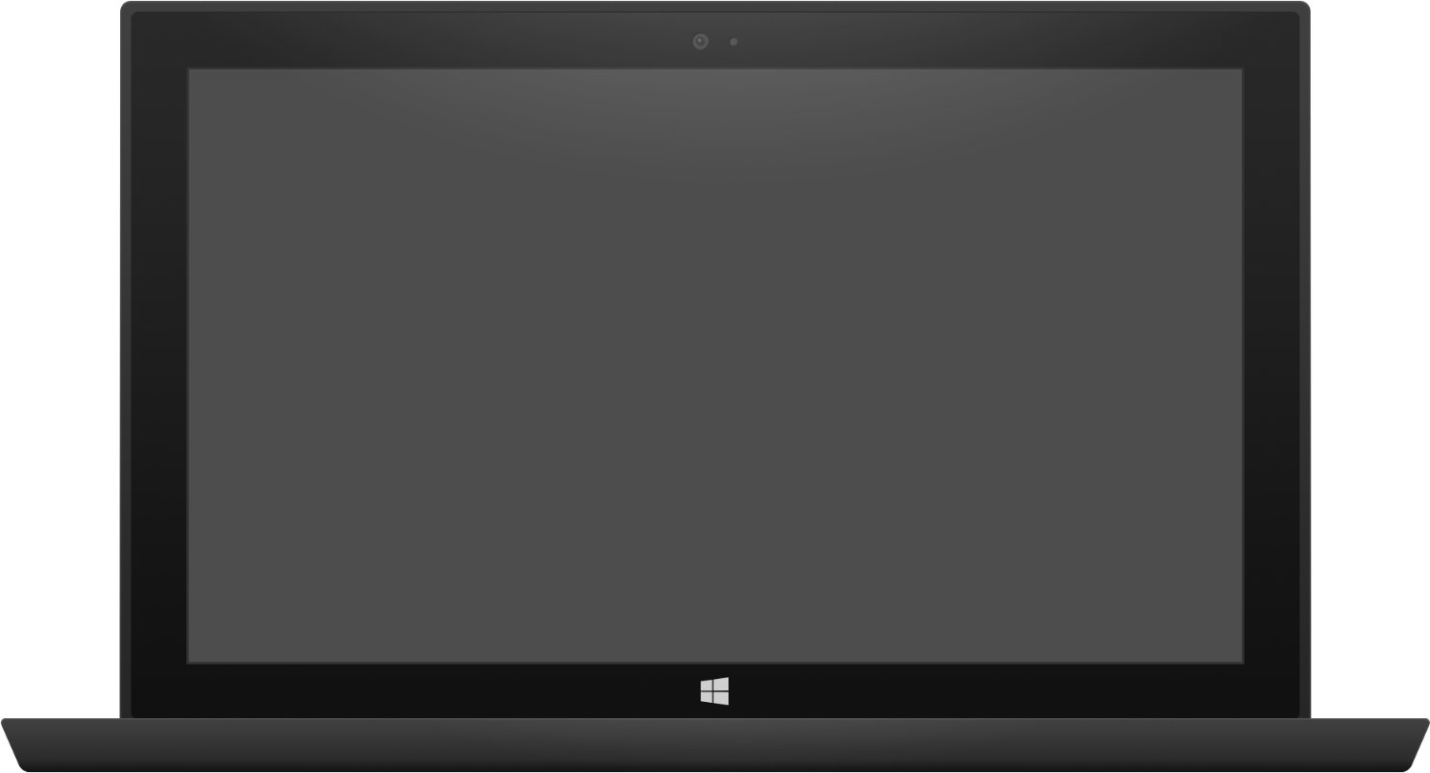

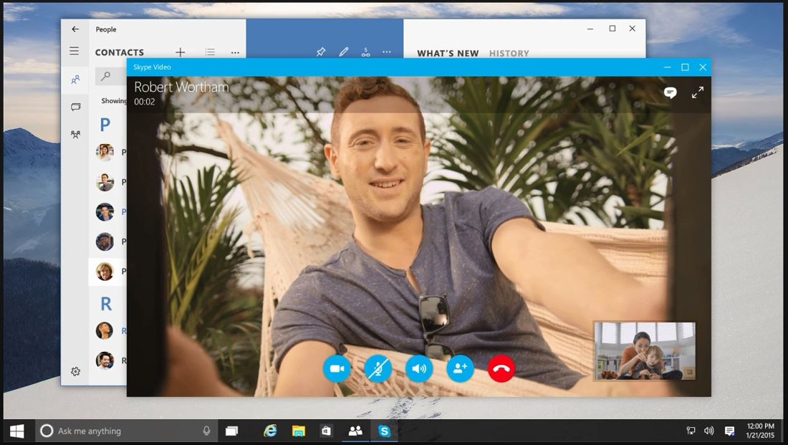

Adaptive design
Tablet (landscape) / Desktop
Phone (portrait)

Slide 28
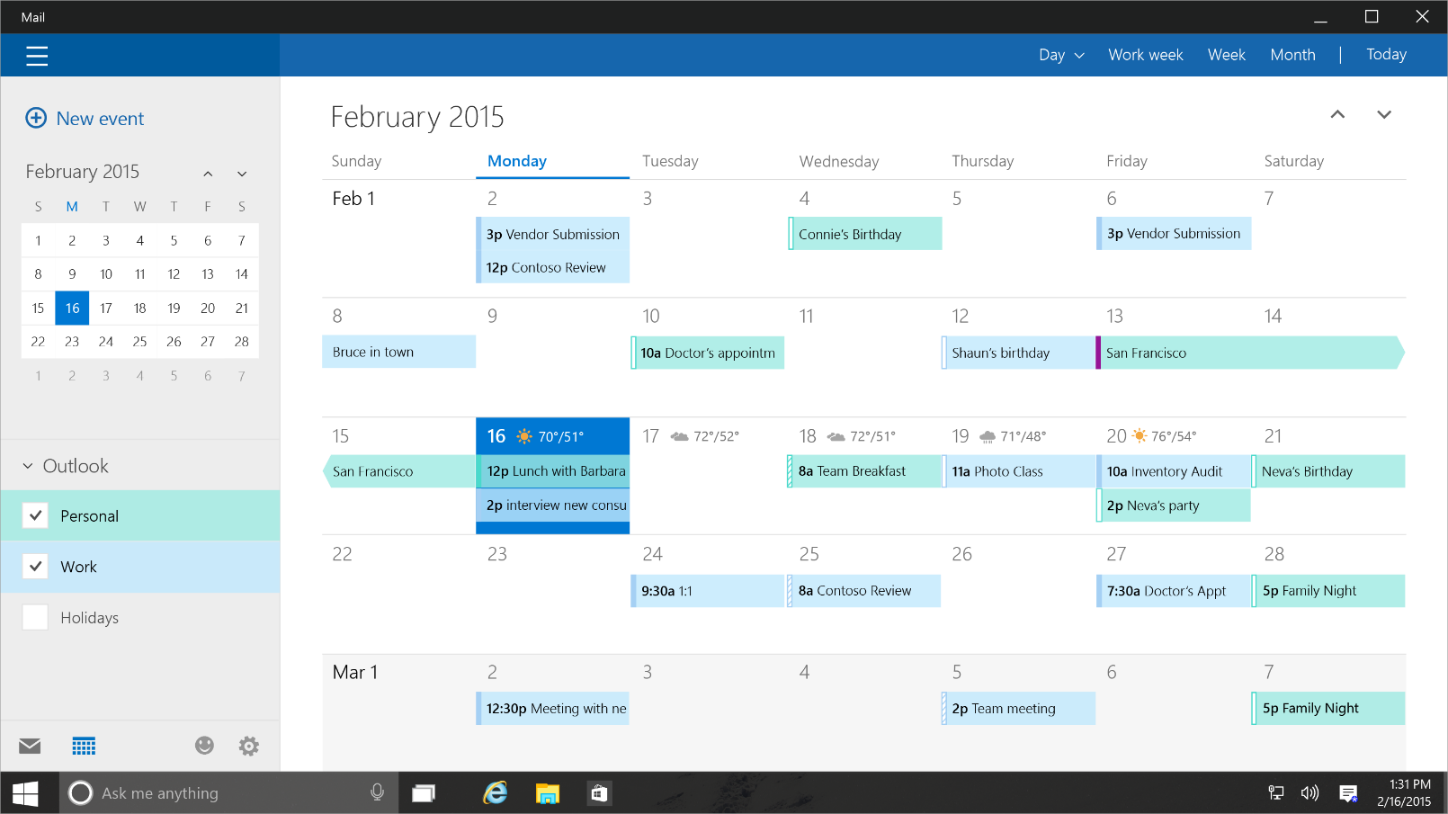
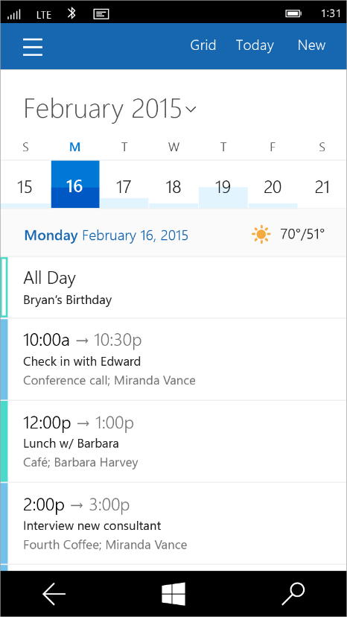
Tailored design
Tablet (landscape) / Desktop
Phone (portrait)

Slide 29
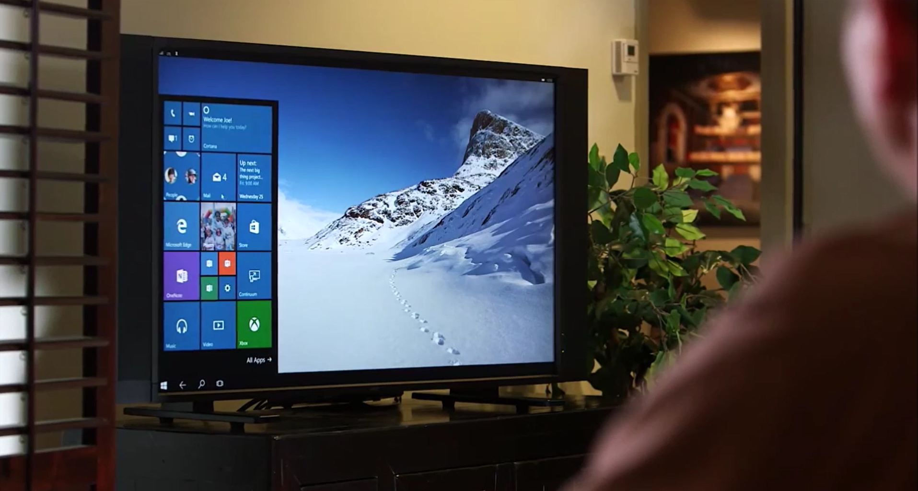
Continuum for Convertibles and Phones
Continuum for convertibles and Phones

Slide 30
Adaptive code
A compatible binary across devices
Universal API with device-specific implementation
Light up our app with capabilities
Testing for capabilities and namespaces

Slide 31
Users love apps that work great on all their devices

Slide 32
Test capabilities at runtime
Use Adaptive Code to light-up your app on specific devices
var api = "Windows.Phone.UI.Input.HardwareButtons";
if (Windows.Foundation.Metadata.ApiInformation.IsTypePresent(api))
{
Windows.Phone.UI.Input.HardwareButtons.CameraPressed += CameraButtonPressed;
}

Slide 33
UAP
UAP
UAP
UAP
Windows Core
Windows Core
Windows Core
Windows Core
Desktop
Mobile
Xbox
More…

Slide 34
The device families you choose determines which APIs you can call freely

Slide 35
One simple, unified, integrated development environment

Slide 36
Visual Studio IDE
Every project type
Desktop, Windows, Phone, Service, Web, Game, More…
Every developer task
Code edit, Architecture design, UX design, Debug, Profile, Review, Test, More…
Every development language
C++/CX, C#, Visual Basic, JavaScript, XAML, HTML, More…
Visual Studio Online
Source repository, project management, bug tracking, More…

Slide 37
Introducing Roslyn, our new compiler for .Net

Slide 38
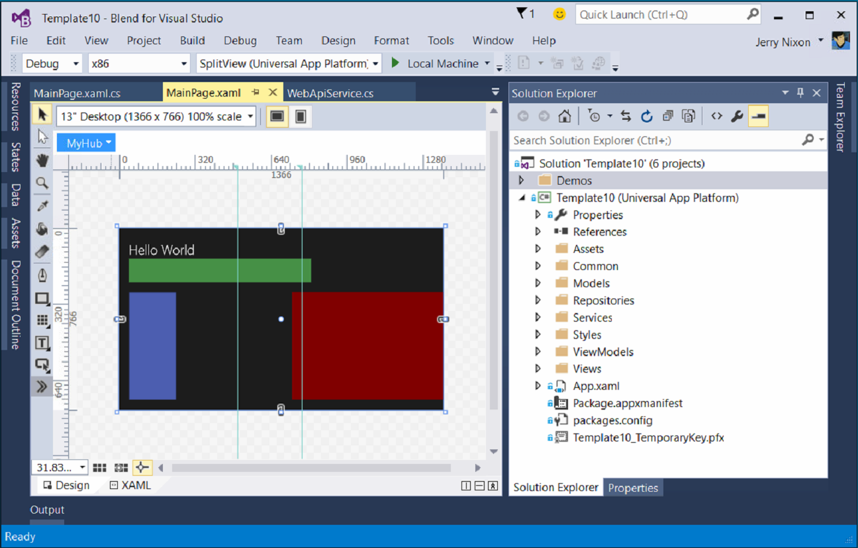
Blend for Visual Studio
The XAML Developer’s IDE
Always part of Visual Studio
Uses the Visual Studio shell
Full auto-complete & intellisense
Validation
Snippets
Peek
File & solution management
Resource management
Data management
Animation
States

Slide 39
Visual Studio 2015 Editions
Enterprise
Architecture Modeling, Diagnostics, VSO/ALM & Release Management
Professional
Architecture Validation, VSO/ALM & Feedback Management
Community Editions
Visual Studio Professional Edition

Slide 40
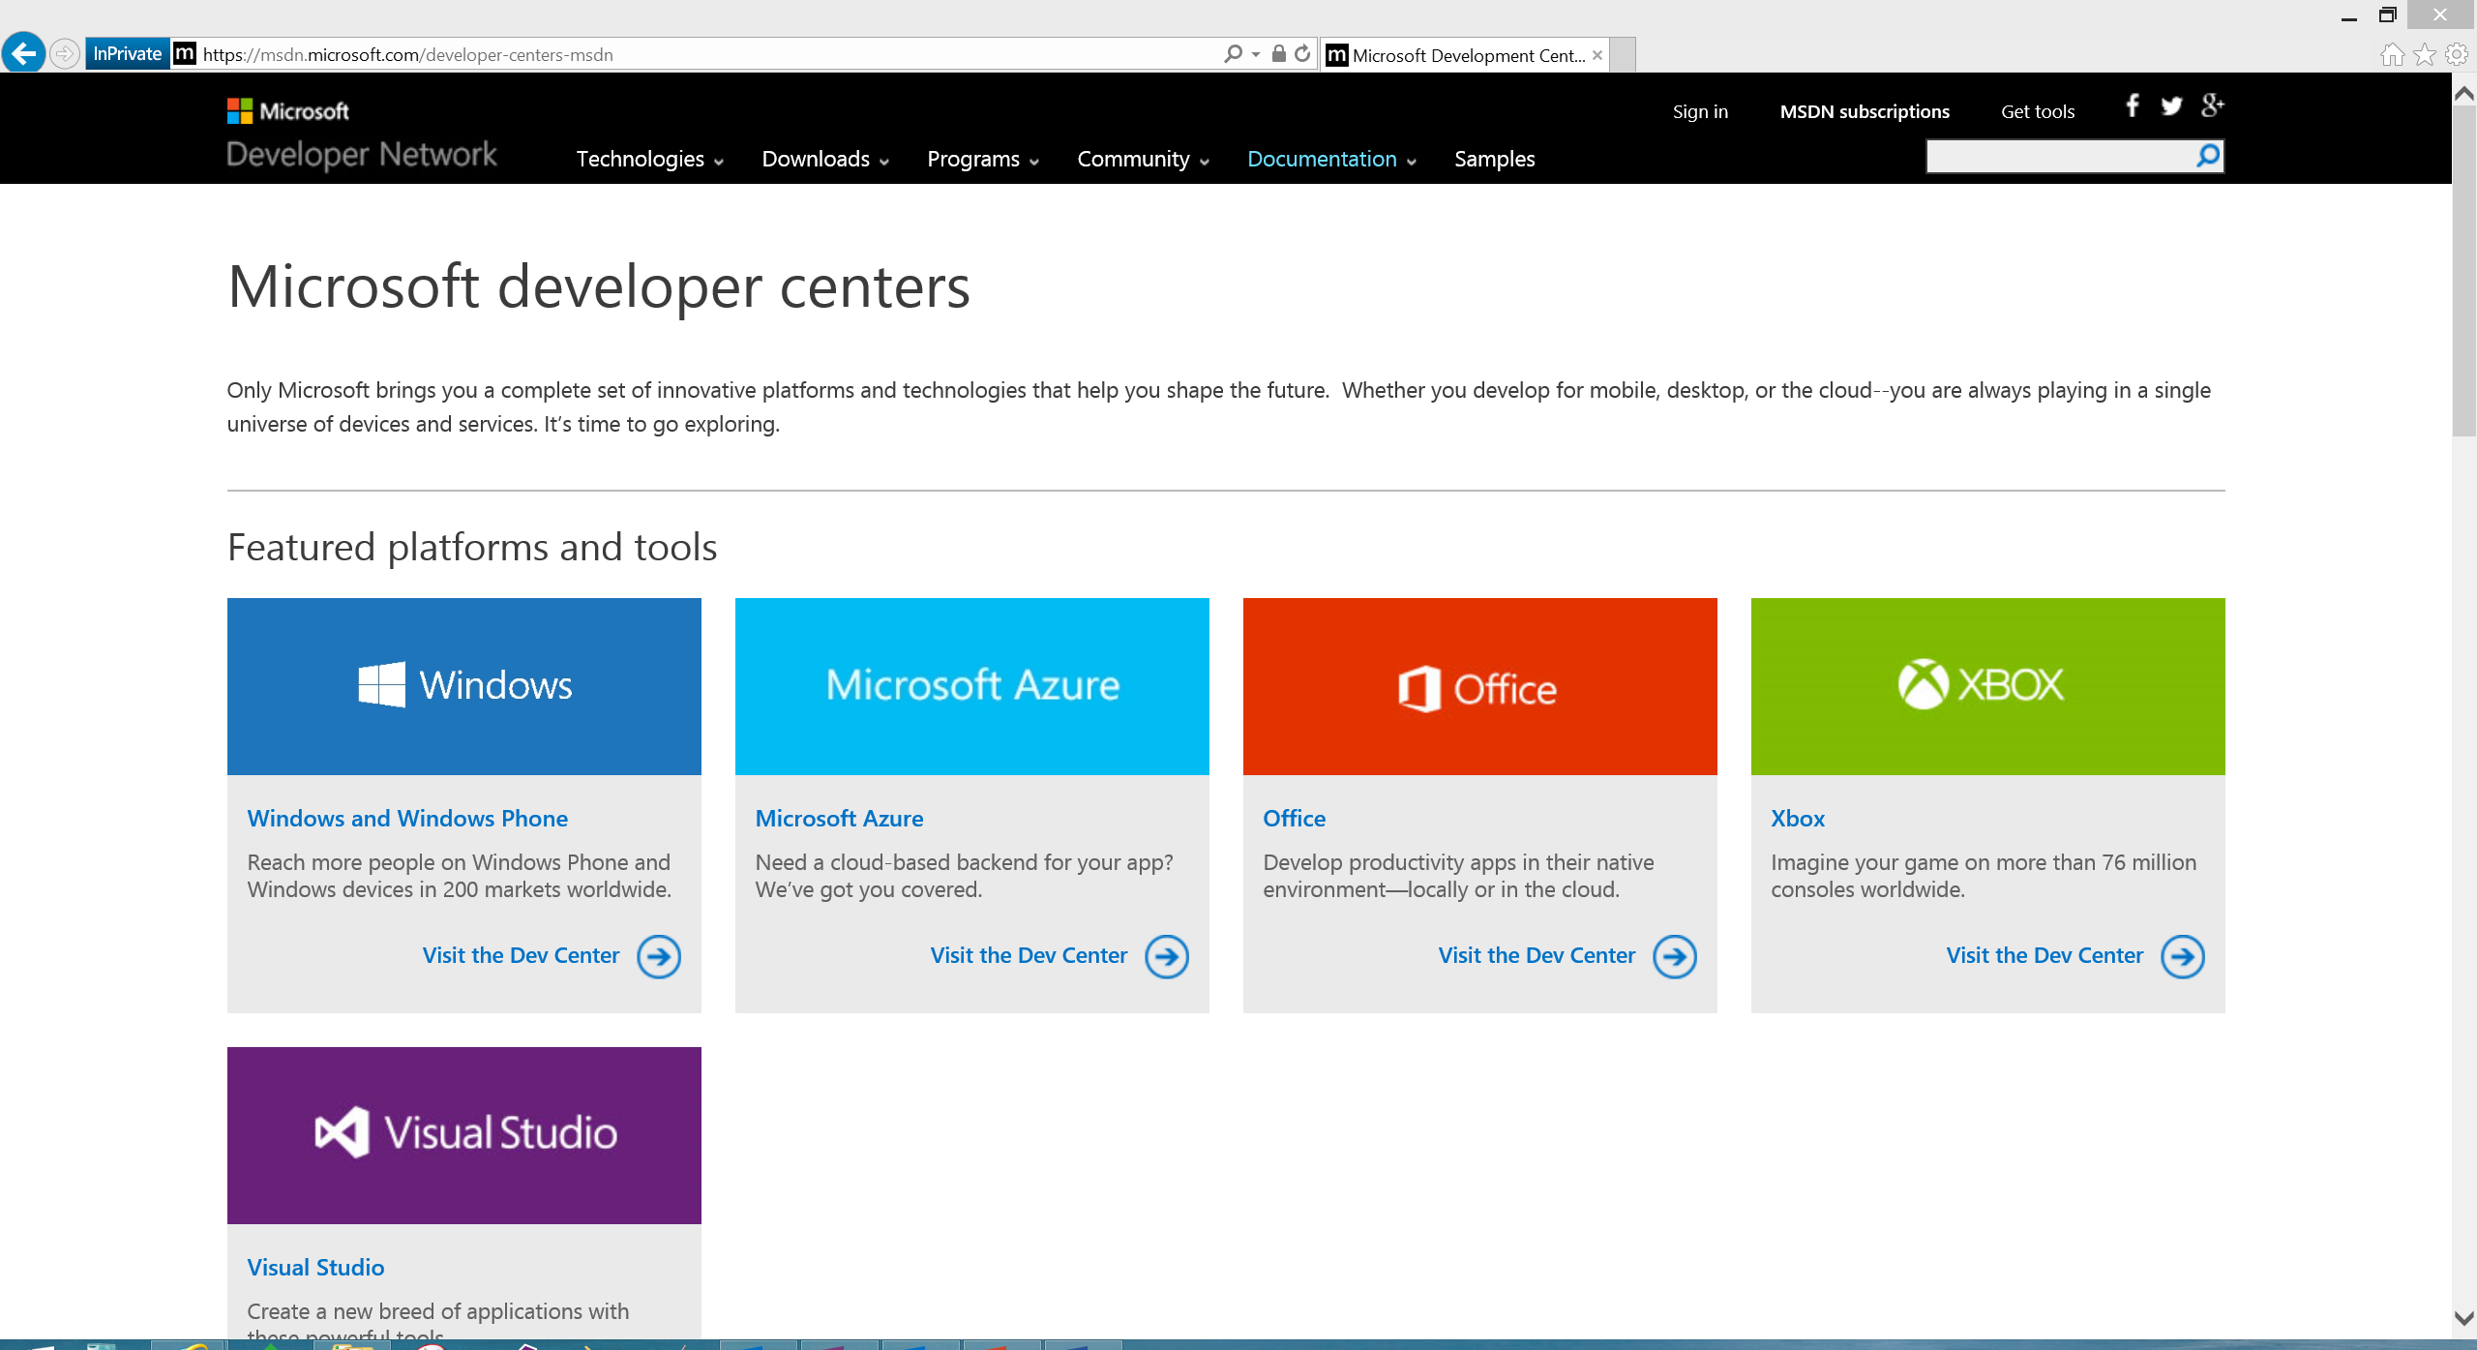
Microsoft Developer Network
Microsoft documentation
http://msdn.Microsoft.com
http://dev.Windows.com
Microsoft training
http://msevents.Microsoft.com
http://MicrosoftVirtualAcademy.com
MSDN Subscription
Operating Systems
Server/Client Products
Developer Tools
Azure/O365 Credits

Slide 41
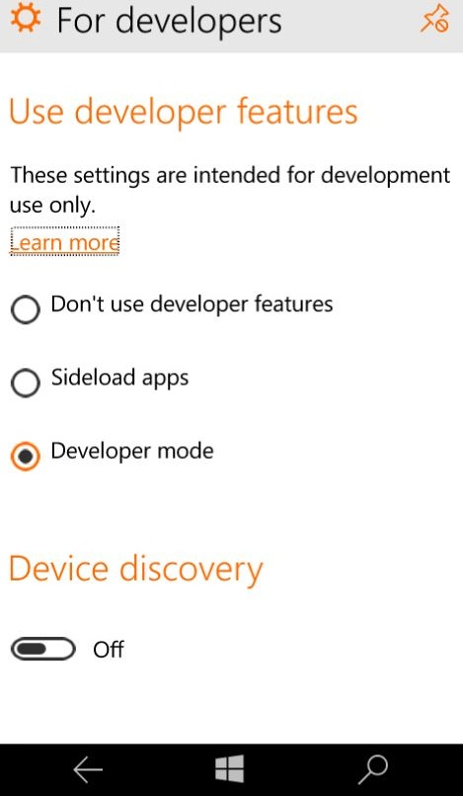
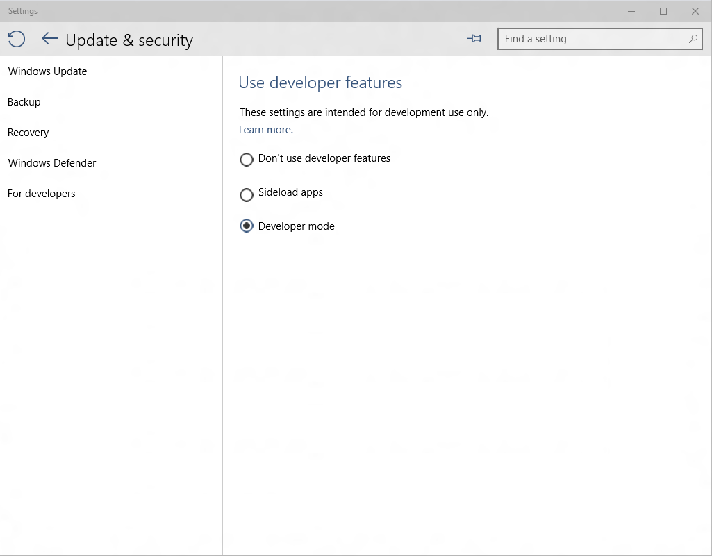
Developer unlock

Slide 42

Where can I develop?
Windows 10
Requires Visual Studio 2015
Windows 8.1 & Windows Server 2012 R2
The Visual Studio designer does not function
Debugging requires a Windows 10 device or Remote Debugging Tools

Slide 43
Managed languages are more efficient than ever

Slide 44
.NET Native
Next generation compiler in the cloud
Every Windows apps, only Windows app (right now)
Apps use the standard C++ optimizer
As optimizer performance improves, so does .Net native
Apps with .Net bootstrapper
Includes garbage collection
There is no runtime
This is machine code

Slide 45
Every Windows app will be compiled with .Net Native

Slide 46
Real benefits with .Net Native
50% faster average startup time
14% less average memory usage

Slide 47
.Net Native enables the platform to update at a faster cadence

Slide 48
Introducing “Template 10”
A new blank template
Includes a few files & empty folders to guide conventions
Similar to the MVC template
Add-on components to solve common problems
Solving for the 90%
The code will solve the 90% use case
Delivering with Windows 10
The template is in GitHub and still under construction

Slide 49
Contribute to Template10 http://aka.ms/template10

Slide 50
A single platform
One Windows
Many devices
Developer experience
Windows tooling
.Net Native
Template 10
http://aka.ms/template10

